Slide 1
OTHER FEATURES
by Mykola Sotula

Slide 2
AGENDA
Template strings
Scoping
Spread

Slide 3
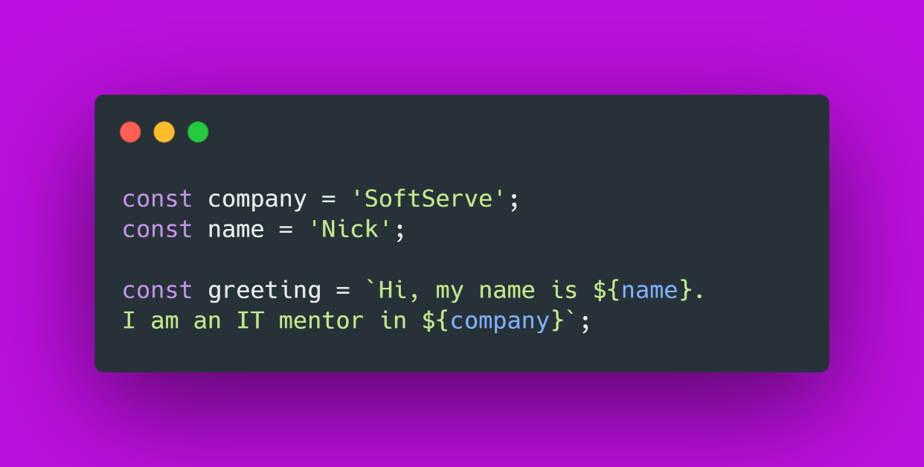
TEMPLATE STRINGS
Template strings are enclosed by the backtick (` `) character instead of double or single quotes.
Template literals can contain placeholders. These are indicated by the dollar sign and curly braces (${expression}).

Slide 4
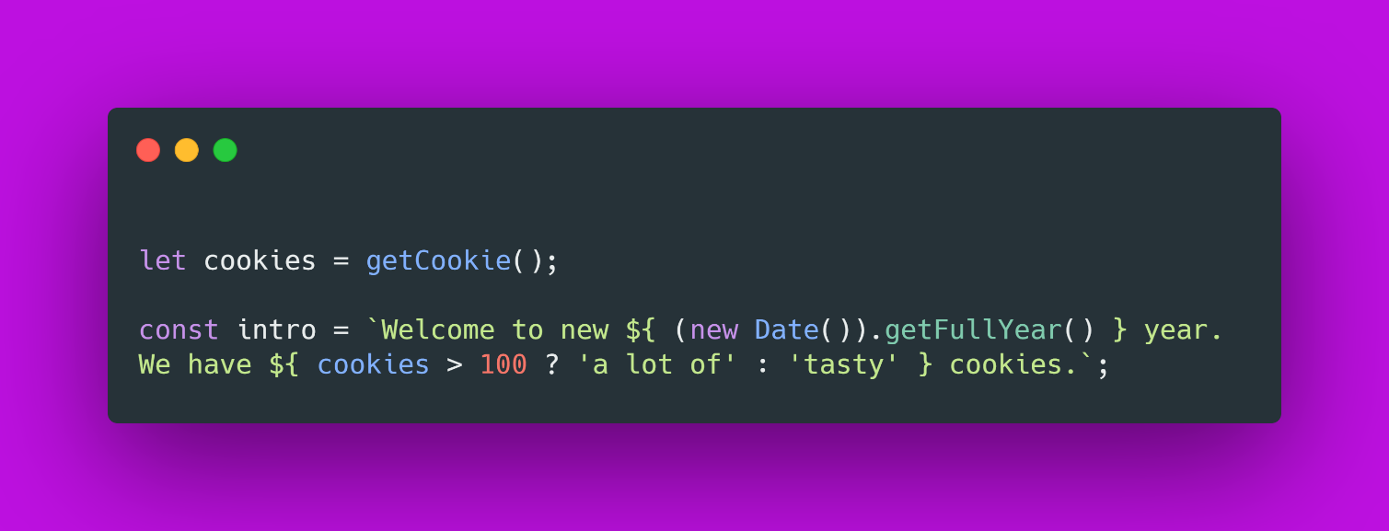
TEMPLATE STRINGS
Template strings bring better:
String interpolation,
Embedded expressions,
Multiline strings without hacks,
String formatting,
String tagging for safe HTML escaping, localization and more.

Slide 5
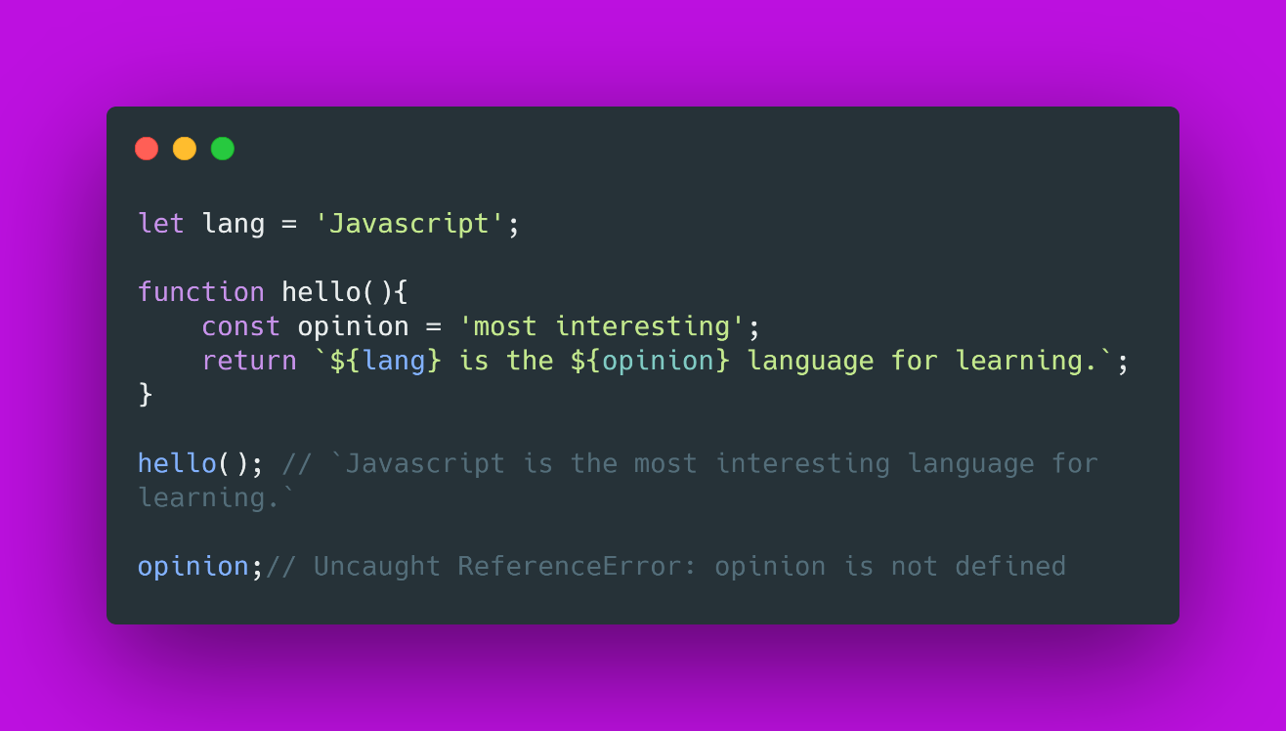
SCOPING
Scope - current context of execution. The context in which values and expressions are "visible" or can be referenced.
If a variable or other expression is not "in the current scope," then it is unavailable for use.

Slide 6
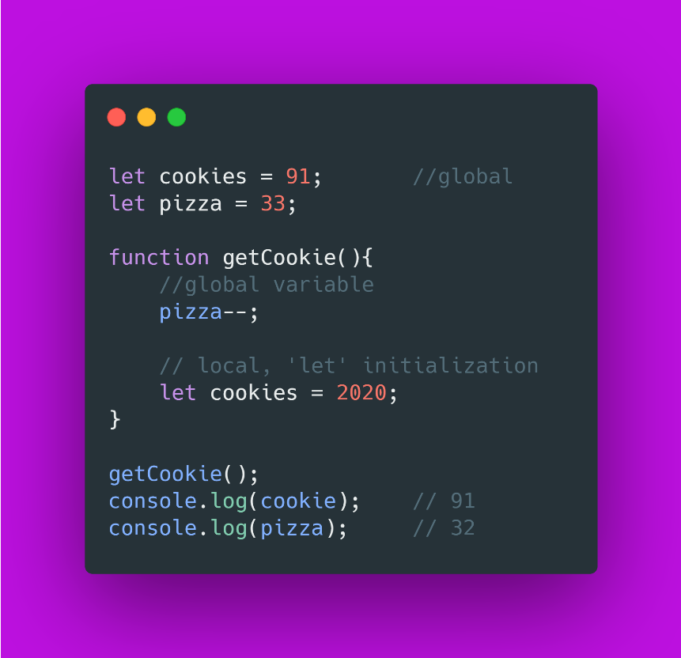
GLOBAL-LOCAL
Scopes can also be layered in a hierarchy, so that child scopes have access to parent scopes, but not vice versa.
A function serves as a closure in JavaScript, and thus creates a scope, so that a variable defined exclusively within the function cannot be accessed from outside the function or within other functions.

Slide 7
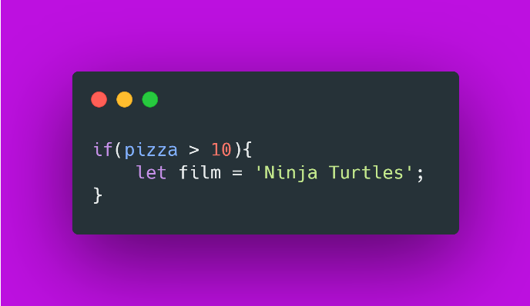
BLOCK
A block statement is used to group zero or more statements. The block is delimited by a pair of braces ("curly brackets") { }
Blocks are commonly used in association with if...else and for statements.

Slide 8
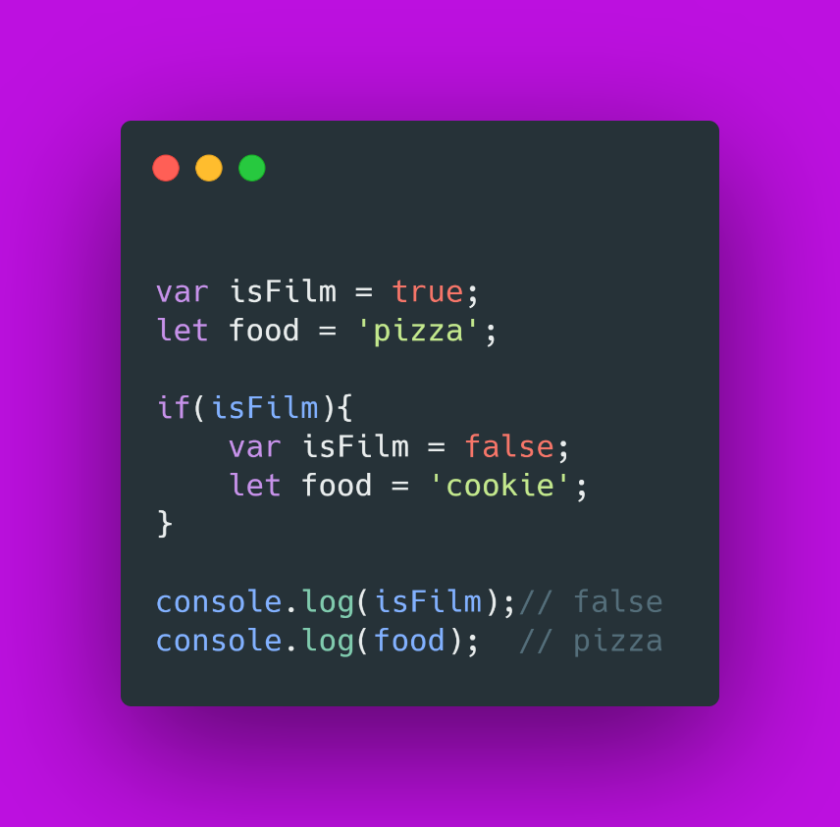
LET, CONST, VAR
Variables declared with var or created by function declarations in non-strict mode do not have block scope.
Variables introduced within a block are scoped to the containing function or script, and the effects of setting them persist beyond the block itself.
In other words, block statements do not introduce a scope.
By contrast, identifiers declared with let and const do have block scope.

Slide 9
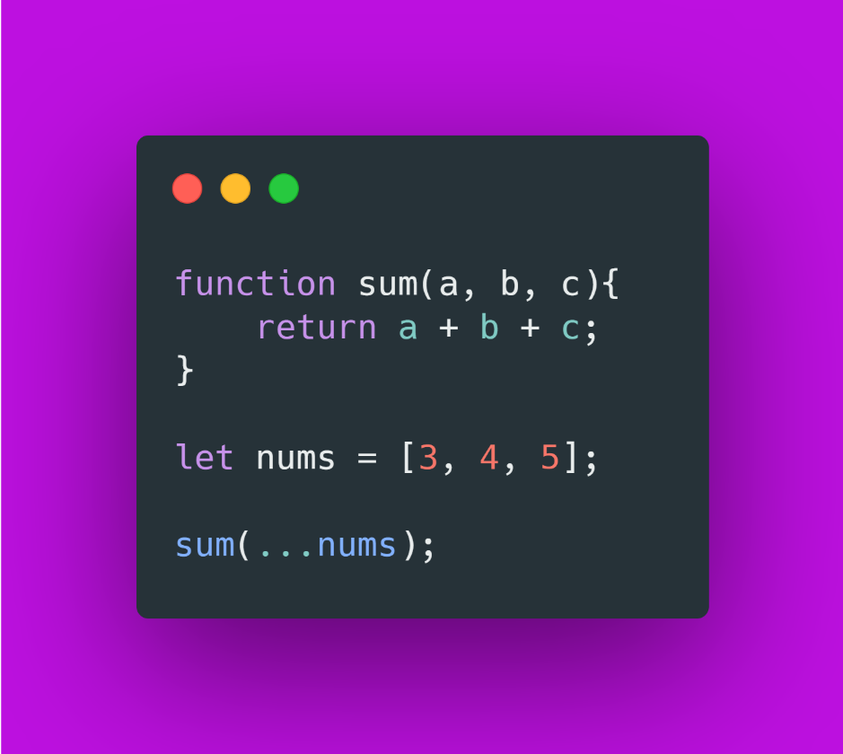
SPREAD
Spread syntax (...) allows an iterable such as an array expression or string to be expanded in places where zero or more arguments (for function calls) or elements (for array literals) are expected, or an object expression to be expanded in places where zero or more key-value pairs (for object literals) are expected.

Slide 10
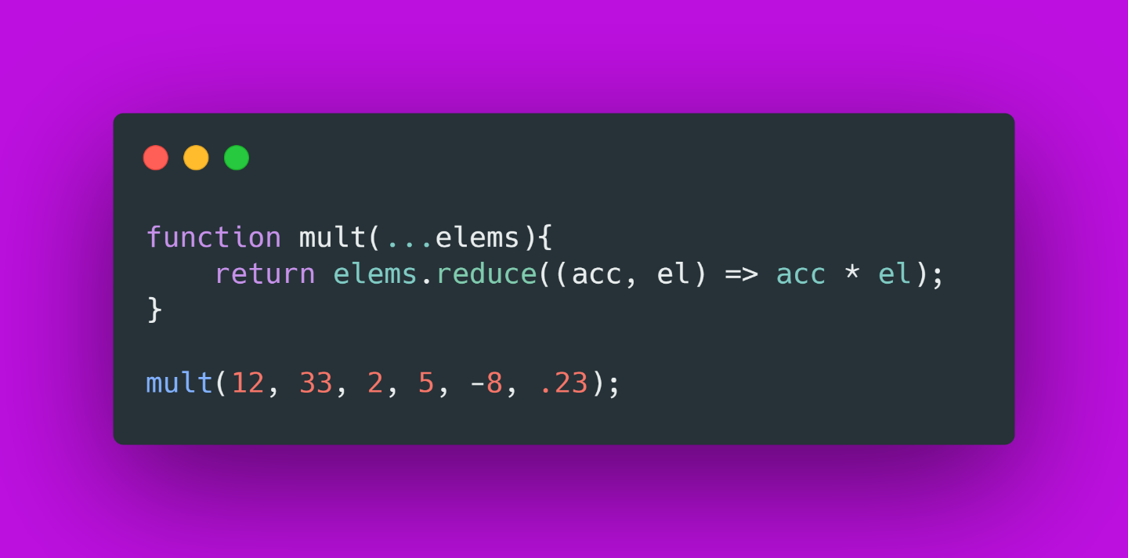
REST
Rest syntax looks exactly like spread syntax. In a way, rest syntax is the opposite of spread syntax.
Spread syntax "expands" an array into its elements, while rest syntax collects multiple elements and "condenses" them into a single element.

Slide 11


